Slide 1

The Memory Game
Steven Moses
Bryan Oliver

Slide 2

BRIEF INTRODUCTION
Just a fun memory training game for you to enjoy! We have two game modes :
Matching Numbers (Easy)
Find the Numbers (Hard)

Slide 3
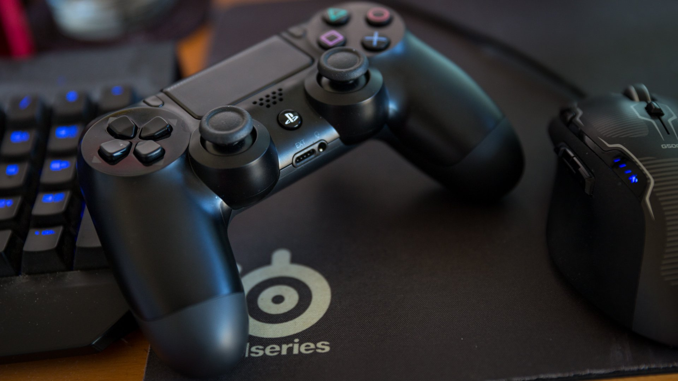
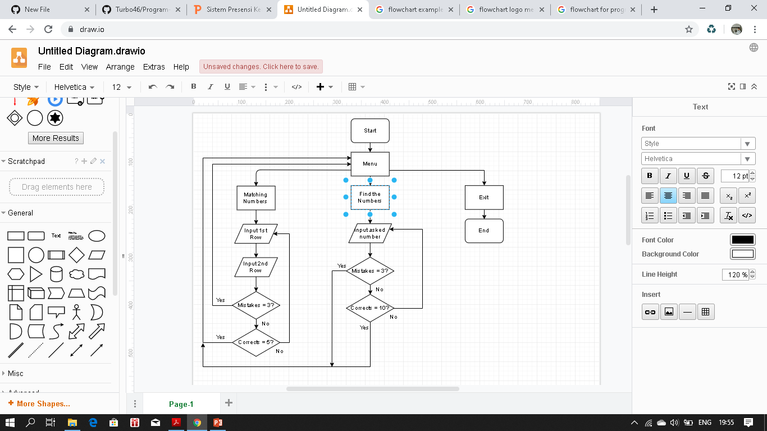
FLOWCHART

Slide 4

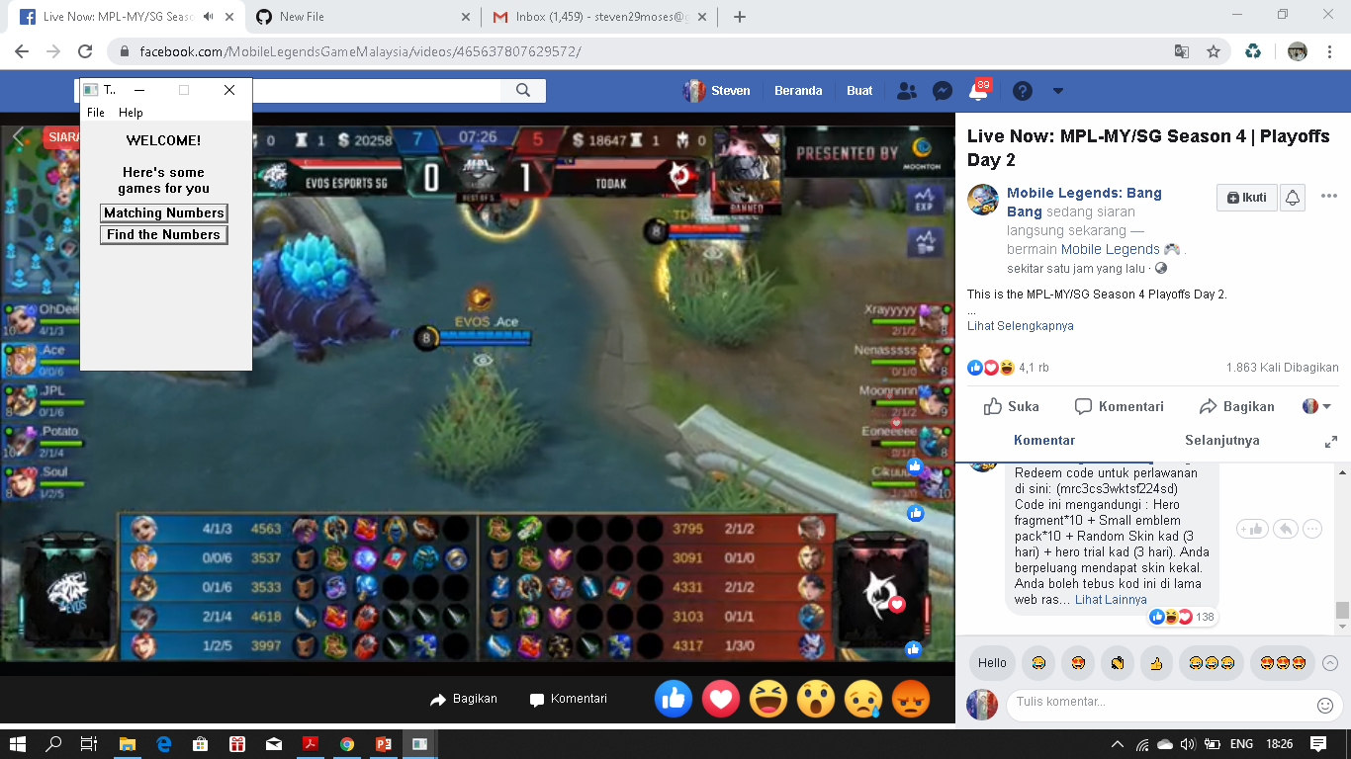
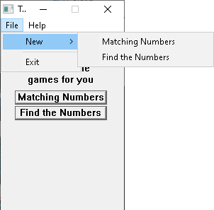
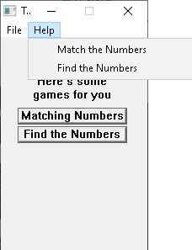
Main Menu
MENU INTERFACE

Slide 5
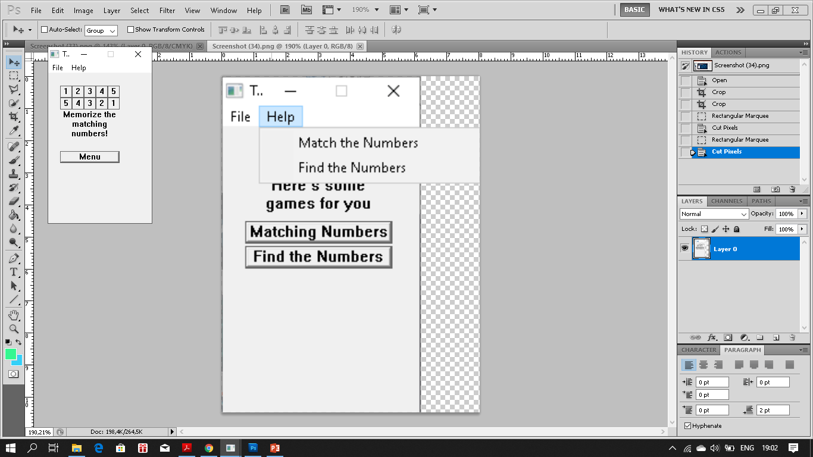
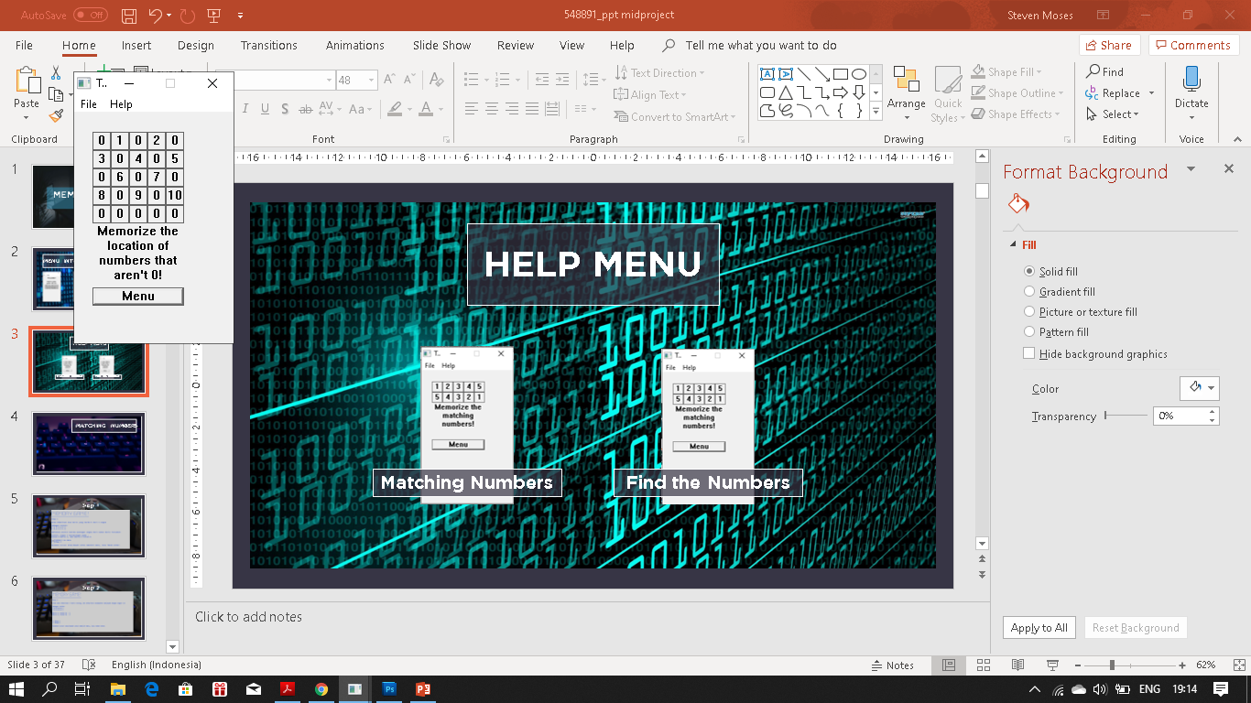
HELP MENU
Matching Numbers
Find the Numbers

Slide 6

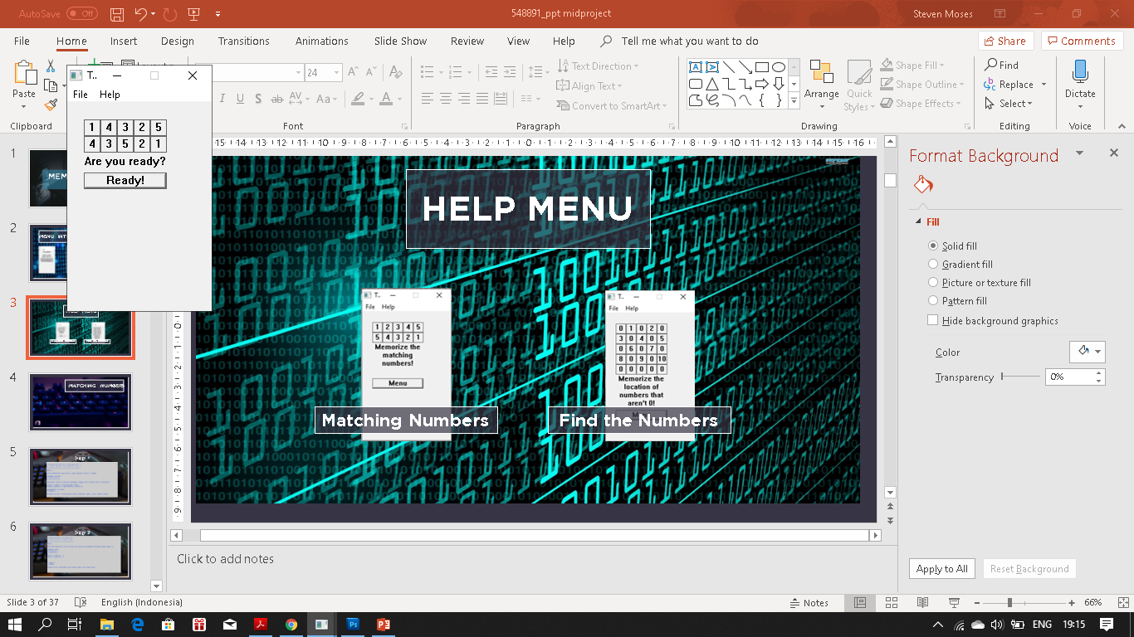


MATCHING NUMBERS
Case
Success
Fail

Slide 7
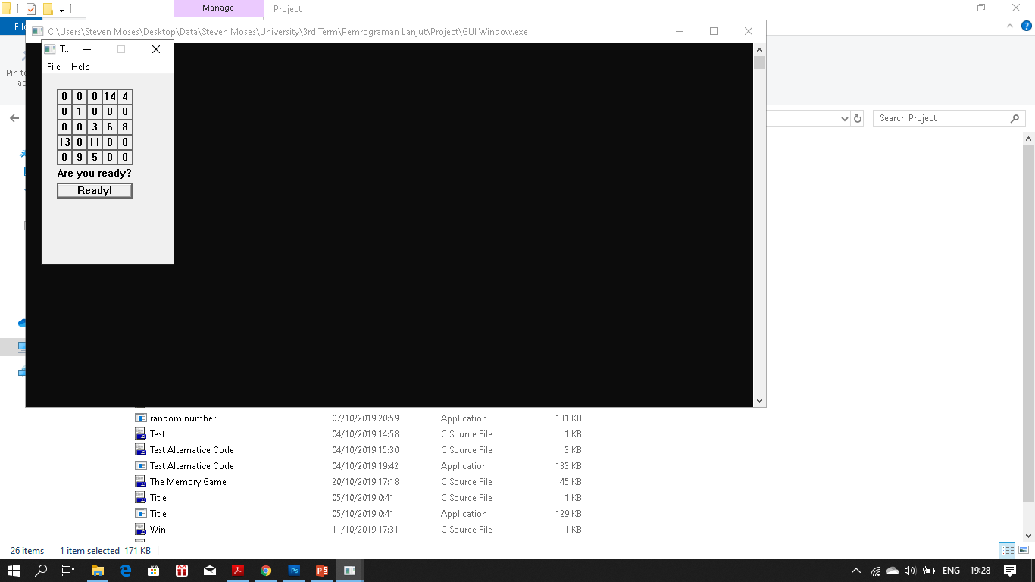
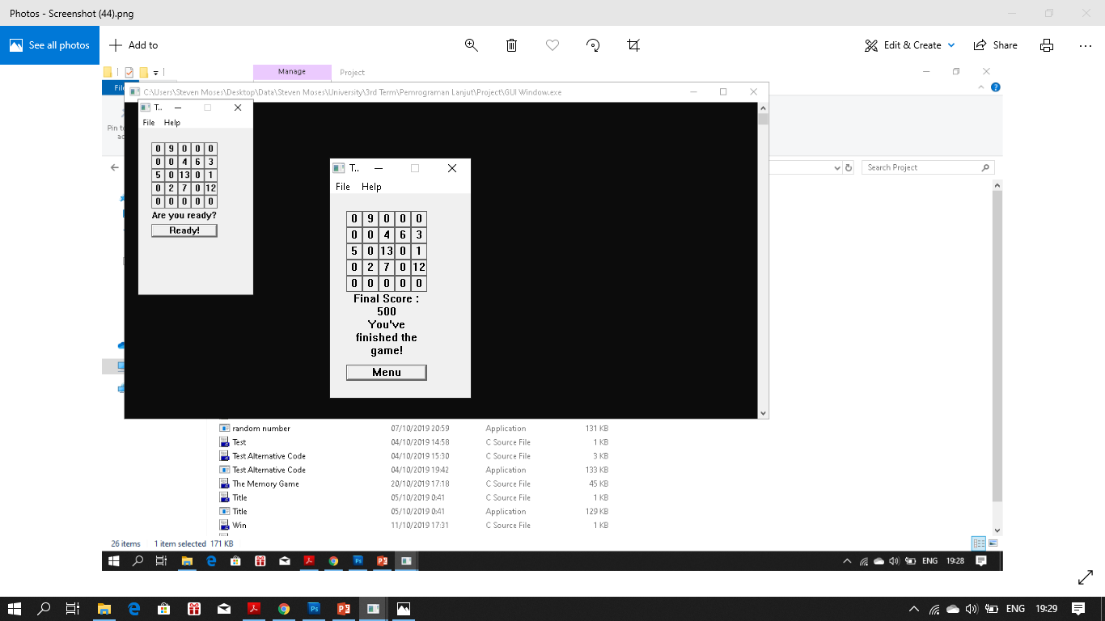

FIND THE NUMBERS
Case
Success
Fail

Slide 8
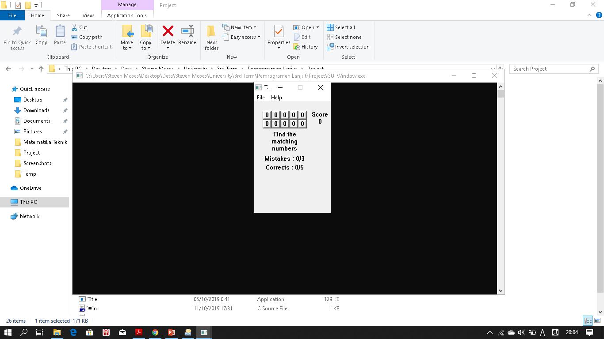

Main Menu
HOW TO PLAY??!!
Just click-click according to :
Match the Top ->
<- With the Bottom
<- This and win it!
Matching Numbers
Find the Numbers

Slide 9

謝謝!
Terima Kasih!
THANK YOU!
どうもありがとう！
감사합니다!

